Slide 1
Parts Crib database
Project Name: Humber parts
by: Masoud Rahguzar
Group MeMbers: Rafil Yashooa, Divesh oree, Gurpreet Jhita

Slide 2
Introduction
Purpose
The purpose of our project is to create a quick and efficient way to take out items from the parts crib and store them in database
How
Our project contains three major components raspberry pi, webcam and a barcode. The webcam will be able to scan barcodes using the code running on raspberry pi (python) and then placed in a txt file.

Slide 3
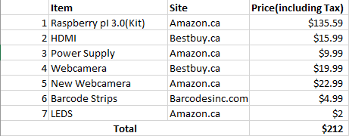
budget

Slide 4
Schedule
Week 12-15
PowerPoint-Presentation
Build Instruction
Filming and 30 second script
Week 1- 6
Proposal
Schedule
Budget
Reports
Mechanical Assembly
Week 7-12
Power-up Milestone
Placard
Build Video
Reports

Slide 5
Build Video
https://masoud647.github.io/

Slide 6
Knowledge from Previous courses
Semester 1
Tech 101: Electrical Circuits
Tech 104: Programming Fundamentals
Semester 2
Tech 150: Electronic Devices and Circuits
Tech 151: PC Hardware and Operating Systems
Semester 3
CENG 212: Programming Techniques in Java
Semester 4
CENG 256: Internet Programming

Slide 7
END Thank you for listening

